Slide 1
V. Predrasude i Problem Solving u Nasilju i Isključivanju
The European Commission support for the production of this publication does not constitute an endorsement of the contents which reflects the views only of the authors, and the Commission cannot be held responsi­ble for any use which may be made of the information contained therein.

Slide 2
Kontakt:
KOORDINATOR PROJEKTA
Sveučilište Litva
Prof. Dr. Rasa Kreivyte
rasa.kreivyte@lsu.lt
Pogledajte nas na:
Webstranici – www.sportsave.eu
Moodle - http://moodle.sportsave.eu/
The European Commission support for the production of this publication does not constitute an endorsement of the contents which reflects the views only of the authors, and the Commission cannot be held responsi­ble for any use which may be made of the information contained therein.

Slide 3
Opis modula
Modul će se usmjeriti na psihološke aspekte predrasuda kao glavne odrednice nasilja i isključenosti. Prema psihološkoj literaturi, predrasuda je procjena izražena prije nego što imate sve potrebne elemente za točnu i pouzdanu prosudbu (Allport, 1954). U socijalnoj psihologiji, predrasuda proizlazi iz specifiče situacije (Billing i Tajfel, 1973). Isto tako, prema Allport-ovoj strategiji iz teorije kontakta (1954), predrasude se mogu umanjiti.
Ovaj modul se sastoji od 5 poglavlja; poglavlja 2 i 5 opisuju prevencije predrasuda, poglavlja 1 i 3 rješavanje konflikta koji proizlaze iz predrasuda, te poglavlje 4 opisuje posljedice nasilja i isključenja koje nastaju zbog predrasuda.
The European Commission support for the production of this publication does not constitute an endorsement of the contents which reflects the views only of the authors, and the Commission cannot be held responsi­ble for any use which may be made of the information contained therein.

Slide 4
Sadržaj
Poglavlje 1. Predrasude i teorija kontakta (Allport, 1952)
Poglavlje 2. Prevencijske strategije
Poglavlje 3. Konflikt
Poglavlje 4. Posljedice nasilja i isključenja
Poglavlje 5. Poticanje poštovanja kroz grupnu dinamiku
The European Commission support for the production of this publication does not constitute an endorsement of the contents which reflects the views only of the authors, and the Commission cannot be held responsi­ble for any use which may be made of the information contained therein.

Slide 5
Poglavlje 1. Predrasude i Teorija Kontakta
The European Commission support for the production of this publication does not constitute an endorsement of the contents which reflects the views only of the authors, and the Commission cannot be held responsi­ble for any use which may be made of the information contained therein.

Slide 6
Poglavlje 1. Predrasude i Teorija Kontakta
PREGLED
Cilj ovog poglavlja je pružiti osnovno znanje o predrasudama, njihovoj funkciji i načinu kako ih smanjiti.
The European Commission support for the production of this publication does not constitute an endorsement of the contents which reflects the views only of the authors, and the Commission cannot be held responsi­ble for any use which may be made of the information contained therein.

Slide 7
Poglavlje 1. Predrasude i Teorija Kontakta
Predrasude
Predrasude su procjena izražena prije nego što imate sve potrebne elemente za točnu i pouzdanu prosudbu.
Pojam “predrasuda” koristi se za označavanje negativnog stava prema društvenoj grupi ili kategoriji ili bilo kome tko je dio grupe, a njeno vrednovanje nije povezano s individualnim karakteristikama.
The European Commission support for the production of this publication does not constitute an endorsement of the contents which reflects the views only of the authors, and the Commission cannot be held responsi­ble for any use which may be made of the information contained therein.

Slide 8
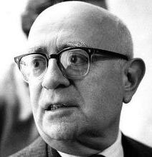
Poglavlje 1. Predrasude i Teorija Kontakta
Glavne teorije o predrasudama
1. Predrasuda kao karakteristika ličnosti
Adorno (1950) – Teorija autoritarne ličnosti:
Predrasude su povezane s određenim infantilnim iskustvom, koje karakterizira
rigidna dispozicija ili psihološka funkcija pojedinaca. Prema Adornu, ako je nečije
obrazovanje (odgoj) bazirano na konstantoj represiji i rigidnim korektivnim
mjerama od strane roditelja, pojedinac će odrasti s iperimpliciranim kogntivnim
funkcioniranjem i velikom osjetljivošću na rasističke ideje i distriminatorna
ponašanja.
.
The European Commission support for the production of this publication does not constitute an endorsement of the contents which reflects the views only of the authors, and the Commission cannot be held responsi­ble for any use which may be made of the information contained therein.

Slide 9
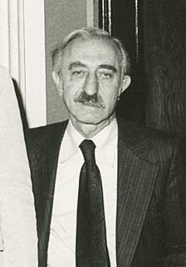
Poglavlje 1. Predrasude i Teorija Kontakta
Glavne teorije predrasuda
Predrasuda kao karakteristika ličnosti
Rockeach (1960) – Dogmatic Personality Theory: osobe koje karakteriziraju diskriminatorna ponašanja imaju kognitivnu strukturu koja im omogućava organizaciju vjerovanja i informacija na izoliran način, ne dopuštajući izražavanje neodgovarajućeg mišljenja.
The European Commission support for the production of this publication does not constitute an endorsement of the contents which reflects the views only of the authors, and the Commission cannot be held responsi­ble for any use which may be made of the information contained therein.

Slide 10
Poglavlje 1. Predrasude i Teorija Kontakta
Glavne teorije predrasuda
Teorija socijalnog identiteta (Tajfel & Turner, 1986)
Svaki put kada razmišljamo o sebi kao članu grupe, govorimo o socijalnom
Identitetu. Razlikujemo tri tri karakteristike socijalnog identiteta:
Ono što znamo o našoj društvenoj grupi;
Emocionalna veza s našom grupom;
Opća vlastita procjena koja proizlazi iz naše grupe (osjećaj ponosa, društveni status, itd.)
The European Commission support for the production of this publication does not constitute an endorsement of the contents which reflects the views only of the authors, and the Commission cannot be held responsi­ble for any use which may be made of the information contained therein.

Slide 11
Poglavlje 1. Predrasude i Teorija Kontakta
Glavne teorije o predrasudama
Teorija socijalnog identiteta (Tajfel & Turner, 1986)
Informacija koju znamo o našoj grupi proizlazi iz procjena koje nas čine pripadnikom određene grupe (ingroup) i razlikuje nas od pripadnika drugih grupa (outgroup).
The European Commission support for the production of this publication does not constitute an endorsement of the contents which reflects the views only of the authors, and the Commission cannot be held responsi­ble for any use which may be made of the information contained therein.

Slide 12
Poglavlje 1. Predrasude i Teorija Kontakta
Ingroup/Outgroup
Kada se poistovjećujemo s grupom (našom grupom = ingroup), razmišljamo o sebi kao zamjenjivom članu grupe, a ne kao jedinstvenom pojedincu. To je normalni proces depresonalizacije koji nije negativan, s obzirom da svoj identitet prebacujemo iz osobnog identiteta u društveni identitet.
Pojedinici koji nisu dio naše društvene grupe percipiraju se kao “ostali” (outgroup) što može dovesti do pojednostavljenih prosudbi izraženih bez dovoljno informacija o toj grupi (tzv. predrasude).
The European Commission support for the production of this publication does not constitute an endorsement of the contents which reflects the views only of the authors, and the Commission cannot be held responsi­ble for any use which may be made of the information contained therein.

Slide 13
Poglavlje 1. Predrasude i Teorija Kontakta
Glavne teorije o predrasudama
Dualna teorija o predrasudama
Ova teorija pretpostavljaja da je ponašanje koje proizlazi iz predrasuda
sastavljeno od dvije komponente, a to su: sama predrasuda i motivacija za
potisnuti predrasudu (Crandall & Eshleman, 2003).
Pojedinici, u namjeri da zadovolje ove dvije komponente, pokazuju
nestabilnost u ponašanju i nedosljednost misli.
The European Commission support for the production of this publication does not constitute an endorsement of the contents which reflects the views only of the authors, and the Commission cannot be held responsi­ble for any use which may be made of the information contained therein.

Slide 14
Poglavlje 1. Predrasude i Teorija Kontakta
Glavne teorije o predrasudama
Istinske predrasude
Istinska predrasuda je negativni stav, naučen u djetinjstvu, koji potiče djelovanje koje se ne temelji na racionalnim procjenama.
Ona se uči od djetinjstva iz roditeljskih stavova.
Primjer: Crnci su intelektualno inferiorni.
The European Commission support for the production of this publication does not constitute an endorsement of the contents which reflects the views only of the authors, and the Commission cannot be held responsi­ble for any use which may be made of the information contained therein.

Slide 15
Poglavlje 1. Predrasude i Teorija Kontakta
Glavne teorije o predrasudama
Čimbenici suzbijanja
Motivaciju za suzbijanje predrasuda predstavlja implicitna norma koja postoji u društvenom okruženju.
Primjer: Nije ispravno izražavati negativne misli o crncima.
The European Commission support for the production of this publication does not constitute an endorsement of the contents which reflects the views only of the authors, and the Commission cannot be held responsi­ble for any use which may be made of the information contained therein.

Slide 16
Poglavlje 1. Predrasude i Teorija Kontakta
Glavne teorije o predrasudama
Dualna teorija
Istinske predrasude + Čimbenici suzbijanja = Izražene predrasude
Primjer: Kada smo pod pritiskom ili uvrijeđeni, mogli bismo imati negativne reakcije prema crncima (regresivni rasizam).
The European Commission support for the production of this publication does not constitute an endorsement of the contents which reflects the views only of the authors, and the Commission cannot be held responsi­ble for any use which may be made of the information contained therein.

Slide 17
Poglavlje 1. Predrasude i Teorija Kontakta
Teorija međugrupnog kontakta (Allport, 1954)
Prema Allportu (1954), mehanizam kojim se mogu umanjiti predrasude objašnjava se hipotezom o međugrupnom kontaktu. Prema autoru, smanjenje predrasuda je moguće ako se utvrdi kontakt između grupa.
The European Commission support for the production of this publication does not constitute an endorsement of the contents which reflects the views only of the authors, and the Commission cannot be held responsi­ble for any use which may be made of the information contained therein.

Slide 18
Poglavlje 1. Predrasude i Teorija Kontakta
Teorija međugrupnog kontakta (Allport, 1954)
Pozitivni učinak kontakta moguć je uz sljedeća četiri uvjeta:
Jednaki status grupa unutar situacije;
Zajednički ciljevi;
Međugrupna suradnja;
Podrška vlasti
The European Commission support for the production of this publication does not constitute an endorsement of the contents which reflects the views only of the authors, and the Commission cannot be held responsi­ble for any use which may be made of the information contained therein.

Slide 19
Poglavlje 1. Predrasude i Teorija Kontakta
Teorija međugrupnog kontakta (Allport, 1954)
Sportski timovi su često međurasni što može uzrokovati česte epizode netolerancije. Teorija međugrupnog kontakta navodi sljedeće načine smanjenja predrasuda:
Jednak status– treneri bi trebali obratiti pozornost da ne ističu nejednakosti među članovima tima (tj. odnositi se prema svim članovima tima jednako)
Zajednički ciljevi– treneri bi trebali usmjeriti pažnju grupe na ostvarenje zajeničkog cilja (npr. ostvariti dobre rezultate u sezoni)
The European Commission support for the production of this publication does not constitute an endorsement of the contents which reflects the views only of the authors, and the Commission cannot be held responsi­ble for any use which may be made of the information contained therein.

Slide 20
Poglavlje 1. Predrasude i Teorija Kontakta
Teorija međugrupnog kontakta(Allport, 1954)
Međugrupna suradnja- trener bi trebao usmjeriti pažnju grupe na postizaje ciljeva (npr. „najvažniji cilj ove sezone je pobjediti. Za postizanje ovog cilja trebate jedan drugoga i vaša međusobna suradnja je neophodna.”)
Podrška vlasti – trener bi trebao promicati norme koje su jasno usmjerene na uzajamno poštovanje i sankcionirati neadekvatna ponašanja.
The European Commission support for the production of this publication does not constitute an endorsement of the contents which reflects the views only of the authors, and the Commission cannot be held responsi­ble for any use which may be made of the information contained therein.

Slide 21
Odjeljak znanja/ Zadaci za vježbu
Samoevaluacijska pitanja:
Što su predrasude?
Kako treneri mogu smanjiti predrasude unutar svog tima?
The European Commission support for the production of this publication does not constitute an endorsement of the contents which reflects the views only of the authors, and the Commission cannot be held responsi­ble for any use which may be made of the information contained therein.

Slide 22
Kraj 1.poglavlja
The European Commission support for the production of this publication does not constitute an endorsement of the contents which reflects the views only of the authors, and the Commission cannot be held responsi­ble for any use which may be made of the information contained therein.

Slide 23
Poglavlje 2. Prevencijske strategije
The European Commission support for the production of this publication does not constitute an endorsement of the contents which reflects the views only of the authors, and the Commission cannot be held responsi­ble for any use which may be made of the information contained therein.

Slide 24
Poglavlje 2. Prevencijske strategije
PREGLED
Cilj ovog poglavlja je odrediti glavna obilježja učinkovitih prevencijskih strategija. Dobar model prevencijske strategije bi se trebao usmjeriti na ciljanu razinu prevencije.
The European Commission support for the production of this publication does not constitute an endorsement of the contents which reflects the views only of the authors, and the Commission cannot be held responsi­ble for any use which may be made of the information contained therein.

Slide 25
Poglavlje 2. Prevencijske strategije
Klasifikacija prevencijskih strategija
Primarna – prevencija djeluje na fenomen koji još nije provjeren;
Sekundarna – prevencijska strategija ima za cilj smanjenje negativnog utjecaja na događaj koji se već dogodio;
Tercijalna – prevencijska strategija ima za cilj smanjenje negativnih posljedica kronične situacije.
The European Commission support for the production of this publication does not constitute an endorsement of the contents which reflects the views only of the authors, and the Commission cannot be held responsi­ble for any use which may be made of the information contained therein.

Slide 26
Poglavlje 2. Prevencijske strategije
1. KORAK: Odrediti problem
Za učinkovitu prevencijsku strategiju je potrebna detaljna analiza problema koji želimo spriječiti. Zbog toga, trebamo saznati što više informacija o problemu, a to možemo koristeći različite kanale kao na primjer observaciju, Internet, knjige, itd.
The European Commission support for the production of this publication does not constitute an endorsement of the contents which reflects the views only of the authors, and the Commission cannot be held responsi­ble for any use which may be made of the information contained therein.

Slide 27
Poglavlje 2. Prevencijske strategije
2.KORAK: Odrediti razinu prevencije
Planiranje intervencije zahtjeva početno utvrđivanje razine prevencije koju želimo provesti.
The European Commission support for the production of this publication does not constitute an endorsement of the contents which reflects the views only of the authors, and the Commission cannot be held responsi­ble for any use which may be made of the information contained therein.

Slide 28
Poglavlje 2. Prevencijske strategije
3. KORAK – Odrediti moguće značajke koje smanjuju problem
Kada imate dovoljno informacija i izaberete razinu prevencije, uz pomoć drugih kolega možete razmisliti o mogućim značajkama koje smanjuju problem.
Jedan od načina za to učiniti je putem brainstorming-a.
The European Commission support for the production of this publication does not constitute an endorsement of the contents which reflects the views only of the authors, and the Commission cannot be held responsi­ble for any use which may be made of the information contained therein.

Slide 29
Poglavlje 2. Prevencijske strategije
4. KORAK – Razviti prevencijski plan
Izrada prevencijskog plana omogućuje odredbu aktivnosti koje mogu pomoći u prevencijskom procesu.
Prevencijski plan bi trebao uključivati sljedeće:
Cilj intervencije
Aktivnosti
Indikatore
The European Commission support for the production of this publication does not constitute an endorsement of the contents which reflects the views only of the authors, and the Commission cannot be held responsi­ble for any use which may be made of the information contained therein.

Slide 30
Poglavlje 2. Prevencijske strategije
5.KORAK – Implementacija
Tijekom implementacijskog procesa bilo bi korisno promatrati dinamiku grupe i voditi bilješke korisne za evaluacijski proces.
The European Commission support for the production of this publication does not constitute an endorsement of the contents which reflects the views only of the authors, and the Commission cannot be held responsi­ble for any use which may be made of the information contained therein.

Slide 31
Poglavlje 2. Prevencijske strategije
6. KORAK – Evaluacija
U ovom procesu bi trebalo provesti opću procjenu prevencijskog programa, uzimajući u obzir indikatore navedene u 4.KORAKU.
Za evaluaciju, trebalo bi uzeti u obzir bilješke iz 5. KORAKA.
The European Commission support for the production of this publication does not constitute an endorsement of the contents which reflects the views only of the authors, and the Commission cannot be held responsi­ble for any use which may be made of the information contained therein.

Slide 32
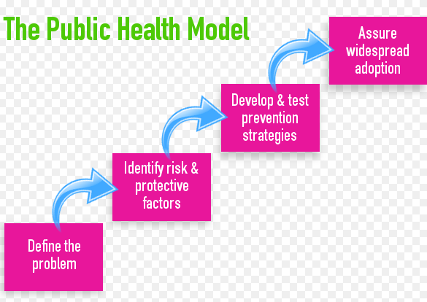
Poglavlje 2. Prevencijske strategije
Primjer
The European Commission support for the production of this publication does not constitute an endorsement of the contents which reflects the views only of the authors, and the Commission cannot be held responsi­ble for any use which may be made of the information contained therein.

Slide 33
Poglavlje 2. Prevencijske strategije
Primjer: Model Javnog Zdravstva
U Sjevernoj Karolini (SAD), prevencija nasilja bila je u središtu pozornosti pet državnih agencija koje su provodile Model Javnog Zdravstva.
Prema tom modelu, prevencijsku strategiju prema nasilju čine sljedeća četiri koraka:
Prvi korak razmatra definiciju problema. Odrediti problem relevantan za zajednicu je od presudne važnosti na početku.
The European Commission support for the production of this publication does not constitute an endorsement of the contents which reflects the views only of the authors, and the Commission cannot be held responsi­ble for any use which may be made of the information contained therein.

Slide 34
Poglavlje 2. Prevencijske strategije
Primjer: Model Javnog Zdravstva
Identifikacija čimbenika rizika i zaštite
U ovom koraku je važno prikupiti informacije o problemu definiranjem čimbenika koji predstavljaju rizik ili zaštitu u određenoj situaciji. To je moguće na sljedeći način:
koristeći već postojeće informacije
kroz samostalno prikupljanje podataka
učenjem onog što drugi rade
The European Commission support for the production of this publication does not constitute an endorsement of the contents which reflects the views only of the authors, and the Commission cannot be held responsi­ble for any use which may be made of the information contained therein.

Slide 35
Poglavlje 2. Prevencijske strategije
Primjer: Model Javnog Zdravstva
Uspostaviti prioritet među čimbenicima
Nakon što se prikupi lista čimbenika rizika i zaštite, važno je utvrditi prioritet među tim čimbenicima, uzimajući u obzir sljedeće karakteristike:
Važnost
Promjenjivost
Izvodljivost
Utjecaj
The European Commission support for the production of this publication does not constitute an endorsement of the contents which reflects the views only of the authors, and the Commission cannot be held responsi­ble for any use which may be made of the information contained therein.

Slide 36
Poglavlje 2. Prevencijske strategije
Primjer: Model Javnog Zdravstva
Kada prikupite sve potrebne podatke, možete razviti i testirati prevencijske strategije.
Konačno, preporuča se osigurati rasprostranjeno prihvaćanje strategije.
The European Commission support for the production of this publication does not constitute an endorsement of the contents which reflects the views only of the authors, and the Commission cannot be held responsi­ble for any use which may be made of the information contained therein.

Slide 37
Odjeljak znanja/ Zadaci za vježbu
Samoevaluacijska pitanja:
Koliko razina razlikujemo u prevencijskom procesu?
Objasni primarni/sekundarni/tercijalni prevencijski proces.
Što je evaluacijski proces?
The European Commission support for the production of this publication does not constitute an endorsement of the contents which reflects the views only of the authors, and the Commission cannot be held responsi­ble for any use which may be made of the information contained therein.

Slide 38
Kraj 2. poglavlja
The European Commission support for the production of this publication does not constitute an endorsement of the contents which reflects the views only of the authors, and the Commission cannot be held responsi­ble for any use which may be made of the information contained therein.

Slide 39
Poglavlje 3. Konflikt
The European Commission support for the production of this publication does not constitute an endorsement of the contents which reflects the views only of the authors, and the Commission cannot be held responsi­ble for any use which may be made of the information contained therein.

Slide 40
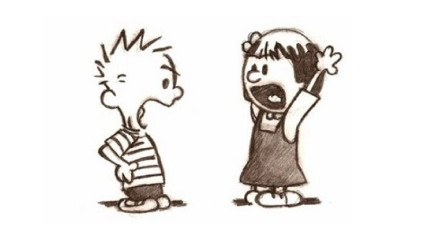
Poglavlje 3. Konflikt
Ovo poglavlje će ispitati psihološku literaturu o konfliktu, njegovim situacijskim čimbenicima i rješavanju konflikta na edukativni način.
The European Commission support for the production of this publication does not constitute an endorsement of the contents which reflects the views only of the authors, and the Commission cannot be held responsi­ble for any use which may be made of the information contained therein.

Slide 41
Poglavlje 3. Konflikt
Definicija:
Konflikt je situacija u kojoj se dvije ili više strana sukobljavaju oko nekompatibilnih interesa.
Konflikt je normalna situacija unutar i između grupa. Zbog tog razloga je korisno znati njegove značajke i način na koji ga rješiti.
The European Commission support for the production of this publication does not constitute an endorsement of the contents which reflects the views only of the authors, and the Commission cannot be held responsi­ble for any use which may be made of the information contained therein.

Slide 42
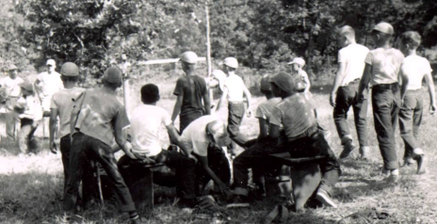
Poglavlje 3. Konflikt
Primjer – Robbers Cave Experiment
1954. Muzafer Sherif i njegova istraživačka grupa su organizirali trotjedni ljetni kamp koji je polazilo 22 djece koja se nikada prije nisu susrela. Svi sudionici su imali 11 godina, i imali su istu kulturalnu, ekonomsku, društvenu i religijsku pozadinu. Uzorak djece je podijeljen u dvije skupine, od kojih je svaka skupina imala zadatak ignorirati postojanje druge.
The European Commission support for the production of this publication does not constitute an endorsement of the contents which reflects the views only of the authors, and the Commission cannot be held responsi­ble for any use which may be made of the information contained therein.

Slide 43
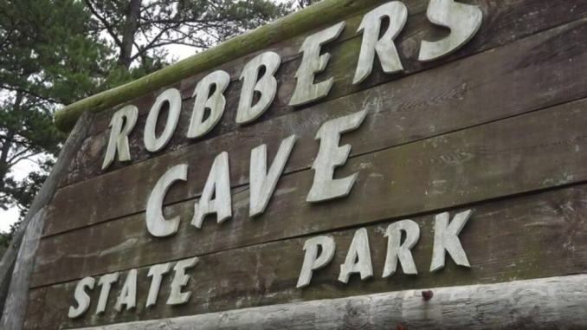
Poglavlje 3. Konflikt
Primjer – Robbers Cave Experiment
Prva faza: Grupna kohezija – za poticanje grupne kohezije organizirane su različite aktivnosti i problem-solving zadaci.
Nakon jednog tjedna grupe su se međusobno otkrile.
The European Commission support for the production of this publication does not constitute an endorsement of the contents which reflects the views only of the authors, and the Commission cannot be held responsi­ble for any use which may be made of the information contained therein.

Slide 44
Poglavlje 3. Konflikt
Primjer – Robbers Cave Experiment
Druga faza: Kontakt s drugom grupom – Brojne natjecateljske aktivnosti su organizirane u svrhu stvaranja nesuglasica između dvije grupe i pobjednička grupa je osvojila neke nagrade. Primjećene su razlike između grupa (ingroup i outgroup), djeca su se počela međusobno vrijeđati što je rezultiralo fizičkom agresijom i nasiljem.
The European Commission support for the production of this publication does not constitute an endorsement of the contents which reflects the views only of the authors, and the Commission cannot be held responsi­ble for any use which may be made of the information contained therein.

Slide 45
Poglavlje 3. Konflikt
Primjer – Robbers Cave Experiment
Treća faza: Smanjenje nesuglasica kroz kontakt – provedene su intervencije za smanjenje nesuglasica; posebice, Sherif je stvorio specifičnu kontaktnu situaciju kako bi upoznao sudionike jedne grupe s drugom grupom; ali sam kontakt nije bio dovoljan za smanjenje tih postupaka.
The European Commission support for the production of this publication does not constitute an endorsement of the contents which reflects the views only of the authors, and the Commission cannot be held responsi­ble for any use which may be made of the information contained therein.

Slide 46
Poglavlje 3. Konflikt
Primjer – Robbers Cave Experiment
Četvrta faza: Smanjenje nesuglasica kroz zadane ciljeve – s ciljem ostvarivanja zajedničkog zadanog cilja (npr., problem s vodom: u kampu nije bilo vode i istraživači su tražili od djece suradnju u otklanjanju štete), djeca su imala zadatak surađivati u rješavanju zajedničkog problema, bez obzira kojoj grupi su pripadala. Ova strategija se pokazala učinkovitom jer su djeca tražila zajedničku večeru posljednju večer ili zajedničku vožnju autobusom na dan povratka.
U psihološkoj literaturi ovo je poznato kao Realistička teorija konflikta.
The European Commission support for the production of this publication does not constitute an endorsement of the contents which reflects the views only of the authors, and the Commission cannot be held responsi­ble for any use which may be made of the information contained therein.

Slide 47
Poglavlje 3. Kontakt
Realistička teorija konflikta (Sherif, 1966)
Prema realističkoj teoriji konflikta (Sherif, 1966), konflikt:
nastaje kada se dvije ili više grupa natječu za ograničena sredstva;
prisutnost zadanih ciljeva koji promiču suradnju.
Ove strategije su učinkovite kod dugotrajnog konflikta.
The European Commission support for the production of this publication does not constitute an endorsement of the contents which reflects the views only of the authors, and the Commission cannot be held responsi­ble for any use which may be made of the information contained therein.

Slide 48
Poglavlje 3. Konflikt
Strategije za upravljanje konfliktom:
Budite mirni – podučavajte svoje sportaše se ne naljute i da mirnim putem rješavaju konfliktnu situaciju;
Ne preuzimajte stranu jednog sportaša– Pokušajte razumijeti oba stajališta i promicati otvorenu komunikaciju kod konfliktnih situacija (ne važi za fizičke konflikte)
Ako je konflikt samo verbalni, potaknite raspravu ispred ostalih članova;
Ako je konflikt fizički, odvojite osobe i raspravite s njima odvojeno od ostatka grupe.
The European Commission support for the production of this publication does not constitute an endorsement of the contents which reflects the views only of the authors, and the Commission cannot be held responsi­ble for any use which may be made of the information contained therein.

Slide 49
Poglavlje 3. Konflikt
Važno je da sportaši razumiju da je dijalog pravi alat za rješavanje konflikta, a ne nasilje.
The European Commission support for the production of this publication does not constitute an endorsement of the contents which reflects the views only of the authors, and the Commission cannot be held responsi­ble for any use which may be made of the information contained therein.

Slide 50
Poglavlje 3. Konflikt
Strategije za prevenciju konflikta
Sportaše treba poticati da konceptualiziraju ljude kao pojedince umjesto jednostavnih članova grupe;
Sportaše treba poticati na uključivanje ostalih pojedinaca izvan neposredne grupe;
Sportaši se trebaju educirati o nizu vjerskih gledišta i praksi.
The European Commission support for the production of this publication does not constitute an endorsement of the contents which reflects the views only of the authors, and the Commission cannot be held responsi­ble for any use which may be made of the information contained therein.

Slide 51
Poglavlje 3. Konflikt
Prijedlozi:
Kada se pojavi konflikt među djecom koji uključuje ozbiljne probleme potrebno je obavijestiti obitelj/roditelje o tome što se dogodilo.
Pri tome se očekuje od trenera da obavijeste roditelje i dogovore se oko zajedničke edukacijske strategije.
The European Commission support for the production of this publication does not constitute an endorsement of the contents which reflects the views only of the authors, and the Commission cannot be held responsi­ble for any use which may be made of the information contained therein.

Slide 52
Odjeljak znanja/ Zadaci za vježbu
Koje strategije možete provesti za rješavanje konflikta?
Koja strategija je prikladna za rješavanje kratkotrajnog konflikta?
Koja strategija je prikladna za rješavanje dugotrajnog konflikta?
The European Commission support for the production of this publication does not constitute an endorsement of the contents which reflects the views only of the authors, and the Commission cannot be held responsi­ble for any use which may be made of the information contained therein.

Slide 53
Kraj 3.poglavlja
The European Commission support for the production of this publication does not constitute an endorsement of the contents which reflects the views only of the authors, and the Commission cannot be held responsi­ble for any use which may be made of the information contained therein.

Slide 54
Poglavlje 4. Posljedice nasilja i isključenja
The European Commission support for the production of this publication does not constitute an endorsement of the contents which reflects the views only of the authors, and the Commission cannot be held responsi­ble for any use which may be made of the information contained therein.

Slide 55
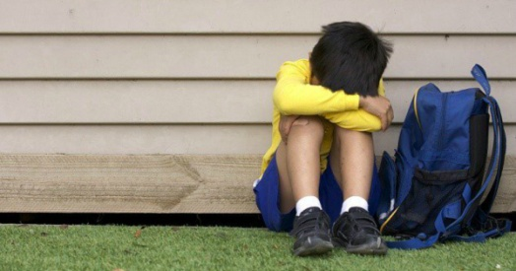
Poglavlje 4. Posljedice nasilja i isključenja
PREGLED
Ovo poglavlje će opisati specifične obrasce za prepoznavanje situacija nasilja i isključenja žrtava.
The European Commission support for the production of this publication does not constitute an endorsement of the contents which reflects the views only of the authors, and the Commission cannot be held responsi­ble for any use which may be made of the information contained therein.

Slide 56
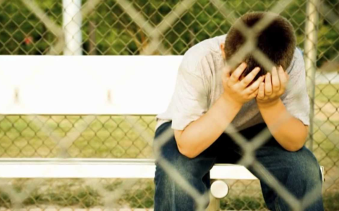
Poglavlje 4. Posljedice nasilja i isključenja
Kratkoročni učinci
Djeca izložena nasilju ili isključenju najčešće pate od sljedećih pojava:
Stres
Depresija
Bespomoćnost
Indiferentnost na nasilje u budućnosti
Nepažljivost prema drugima
Nasilnost
The European Commission support for the production of this publication does not constitute an endorsement of the contents which reflects the views only of the authors, and the Commission cannot be held responsi­ble for any use which may be made of the information contained therein.

Slide 57
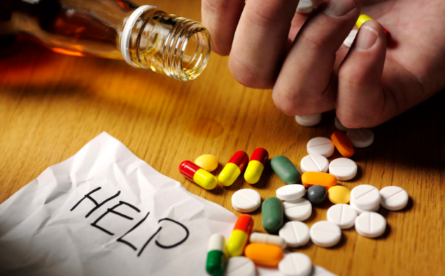
Poglavlje 4. Posljedice nasilja i isključenja
Dugoročni učinci
Dugoročno, vjerovatnije je da će tijekom rasta i razvoja pojedinci patiti od sljedećih čimbenika:
Zloupotreba droga i alkohola
Loše mentalno zdravlje
Rizično seksualno ponašanje
Kriminal
Zloupotreba roditeljstva
The European Commission support for the production of this publication does not constitute an endorsement of the contents which reflects the views only of the authors, and the Commission cannot be held responsi­ble for any use which may be made of the information contained therein.

Slide 58
Poglavlje 4. Posljedice nasilja i isključenja
Što istraživanja kažu…
Istraživanje je pokazalo da ako djeca imaju pomoć odraslih u identificiranju negativnih emocija i generiranju pozitivnih odgovora, njihova emocionalna inteligencija se poboljšava (Smith & Sandho, 2004).
U tim programima negativne emocije se doživljavaju kao prilike za razumijevanje.
Trener bi trebao pomoći djeci u identifikaciji i istraživanju njihovih emocija i razvoju društveno prihvaćenih emocionalnih izraza.
The European Commission support for the production of this publication does not constitute an endorsement of the contents which reflects the views only of the authors, and the Commission cannot be held responsi­ble for any use which may be made of the information contained therein.

Slide 59
Poglavlje 4. Posljedice nasilja i isključenja
Što istraživanja kažu…
Nemogućnost integriranja negativnih emocija u iskustvo djece je povezano s potencijalno štetnim posljedicama kao depresija ili smanjen imunitet.
Važno je uputiti djecu u proces prepoznavanja emocije jer oblici kao što su zabrinjavajuća ili ruminativna misao mogu imati negativni učinak i povećati samu negativnu emociju (Pennebaker, 2004).
The European Commission support for the production of this publication does not constitute an endorsement of the contents which reflects the views only of the authors, and the Commission cannot be held responsi­ble for any use which may be made of the information contained therein.

Slide 60
Poglavlje 4. Posljedice nasilja i isključenja
Istraživanja pokazuju da oni koji učinkovito procesuiraju emocije, imaju i sljedeće sposobnosti:
Emocionalna jasnoća: sposobnost prepoznavanja emocija;
Emocionalni popravak: sposobnost rješavanja emocionalnih problema;
Neka istraživanja su pokazala da mladima nedostaje afektivi rječnik i srodna emocionalna svijest potrebna za konstruktivno rješavanje konflikta (Heydenberk & Heydenberk, 2005).
The European Commission support for the production of this publication does not constitute an endorsement of the contents which reflects the views only of the authors, and the Commission cannot be held responsi­ble for any use which may be made of the information contained therein.

Slide 61
Poglavlje 4. Posljedice nasilja i isključenja
Program prevencije nasilja
Cilj programa prevencije nasilja je bio razviti program obuke za djecu koji će im pomoći kako se nositi s konfliktom na pozitivan način.
Neke specifične aktivnosti obuke su provedene:
Prijava
Mirno biće
Krug rješavanja konflikta
Dnevnici mira
The European Commission support for the production of this publication does not constitute an endorsement of the contents which reflects the views only of the authors, and the Commission cannot be held responsi­ble for any use which may be made of the information contained therein.

Slide 62
Poglavlje 4. Posljedice nasilja i isključenja
Prijava
Na početku svakog dana, sva djeca su bila potaknuta izraziti svoje emocionalne stanje dajući informaciju kroz i-Messages (“Osjećao/osjećala sam se”, “Bio/Bila sam…”, itd.).
Cilj je dvostran: s jedne strane djeca uče kako imenovati svoje emocije; s druge strane djeca počinju razumijeti osjećaje drugih razvijajući empatiju.
Isto tako, djeci nije bilo dozvoljeno koristiti i-Messages kako bi se žalili ili krivili druge.
The European Commission support for the production of this publication does not constitute an endorsement of the contents which reflects the views only of the authors, and the Commission cannot be held responsi­ble for any use which may be made of the information contained therein.

Slide 63
Poglavlje 4. Posljedice nasilja i isključenja
Mirno biće
Djeca su imala zadatak izraditi siluetu u prirodnoj veličini. Nakon toga, zadatak je bio navesti primjere pozitivnog ili negativnog ponašanja. Za svako od negativnih ponašanja, djeca su imala zadatak razmisliti o alternativnom mirnom ponašanju koja su onda zapisivali na siluetu i koje je služilo kao podsjetnik za odgovarajuću interakciju s ostalima.
The European Commission support for the production of this publication does not constitute an endorsement of the contents which reflects the views only of the authors, and the Commission cannot be held responsi­ble for any use which may be made of the information contained therein.

Slide 64
Poglavlje 4. Posljedice nasilja i isključenja
Krug rješavanja konflikta
Na sredini učionice se nalazio mali plastični prsten i nekoliko djece je imalo zadatak ostati izvan sredine i rješiti hipotetske konflikte.
Pravila su bila sljedeća:
svako dijete priča o svojoj verziji problema bez ometanja od strane drugih;
svako dijete mora preformulirati razumijevanje perspektiva drugih osoba;
suparnici surađuju u pronalasku prihvatljivog rješenja problema.
The European Commission support for the production of this publication does not constitute an endorsement of the contents which reflects the views only of the authors, and the Commission cannot be held responsi­ble for any use which may be made of the information contained therein.

Slide 65
Poglavlje 4. Posljedice nasilja i isključenja
Dnevnici mira
Djeca su imala zadatak voditi dnevnik mira, u kojoj su povremeno crtala mirna bića, zapisivala svoje osjećaje, i crtala mirna ponašanja.
Rezultati:
Ovaj kurikulum je pomogao u smanjenju fizičkog i verbalnog nasilja u razredima u kojima je proveden.
The European Commission support for the production of this publication does not constitute an endorsement of the contents which reflects the views only of the authors, and the Commission cannot be held responsi­ble for any use which may be made of the information contained therein.

Slide 66
Odjeljak znanja/ Zadaci za vježbu
Prema onome što je proizašlo iz grupne rasprave, koje su moguće strategije nošenja s kratkoročnim posljedicama nasilja?
The European Commission support for the production of this publication does not constitute an endorsement of the contents which reflects the views only of the authors, and the Commission cannot be held responsi­ble for any use which may be made of the information contained therein.

Slide 67
Kraj 4. poglavlja
The European Commission support for the production of this publication does not constitute an endorsement of the contents which reflects the views only of the authors, and the Commission cannot be held responsi­ble for any use which may be made of the information contained therein.

Slide 68
Poglavlje 5. Promicanje poštovanja kroz grupnu dinamiku
The European Commission support for the production of this publication does not constitute an endorsement of the contents which reflects the views only of the authors, and the Commission cannot be held responsi­ble for any use which may be made of the information contained therein.

Slide 69
Poglavlje 5. Promicanje poštovanja kroz grupnu dinamiku
PREGLED
U ovom poglavlju treneri će naučiti kako promicati poštovanje među djecom kroz grupnu dinamiku.
Prestaviti će se pristup Pozitivnog razvoja mladih (PYD).
The European Commission support for the production of this publication does not constitute an endorsement of the contents which reflects the views only of the authors, and the Commission cannot be held responsi­ble for any use which may be made of the information contained therein.

Slide 70
Poglavlje 5. Promicanje poštovanja kroz grupnu dinamiku
Pristup Pozitivnog razvoja mladih
Perspektiva PYD smatra djecu i adolescente resursima koje treba razviti, a ne problemima kojima treba upravljati.
Prevencija negativnih ponašanja posredovana je promicanjem vještina, kompetencija, vrijednosti i zdravih ponašanja, a fizička aktivnost je savršena domena za postizanje tih ciljeva.
The European Commission support for the production of this publication does not constitute an endorsement of the contents which reflects the views only of the authors, and the Commission cannot be held responsi­ble for any use which may be made of the information contained therein.

Slide 71
Poglavlje 5. Promicanje poštovanja kroz grupnu dinamiku
Pristup Pozitivnog razvoja mladih
PYD pristup predlaže da se vještine kao empatija, odnos s vršnjacima, timski rad, kompetencije i atributi trebaju promišljeno i sustavno podučavati, vježbati, poboljšavati i primjenjivati, isto kao i motoričke sposobnosti.
The European Commission support for the production of this publication does not constitute an endorsement of the contents which reflects the views only of the authors, and the Commission cannot be held responsi­ble for any use which may be made of the information contained therein.

Slide 72
Poglavlje 5. Promicanje poštovanja kroz grupnu dinamiku
Pristup Pozitivnog razvoja mladih
Ovaj pristup predstavljen je kroz 5C model:
Kompetencija (competence) – društvene, akademske, i kognitivne sposobnosti;
Samopouzdanje (confidence) – samoefikasnost, samopoštovanje;
Karakter (character) – poštivanje društvenih i kulturnih normi;
Povezanost (connection) – pozitivna razmjena između vršnjaka, obitelji, škole i zajednice;
Briga (caring) – prihvaćanje osjećaja empatije i suosjećanja.
Kada se postignu svih 5C, može se izrealizirati i 6.C, tj. doprinos (contribution).
The European Commission support for the production of this publication does not constitute an endorsement of the contents which reflects the views only of the authors, and the Commission cannot be held responsi­ble for any use which may be made of the information contained therein.

Slide 73
Poglavlje 5. Promicanje poštovanja kroz grupnu dinamiku
Pristup Pozitivnog razvoja mladih (PYD)
Omogućiti jasna i dosljedna pravila i očekivanja;
Osigurati priliku za učenje i unaprijeđenje fizičkih, socijalnih, i psiholoških kompetencija;
Osigurati informativne povratne informacije ovisno o postiguću;
Osigurati priliku za ravojem topline, brige i poštovanja u budućnosti.
The European Commission support for the production of this publication does not constitute an endorsement of the contents which reflects the views only of the authors, and the Commission cannot be held responsi­ble for any use which may be made of the information contained therein.

Slide 74
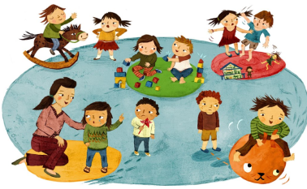
Poglavlje 5. Promicanje poštovanja kroz grupnu dinamiku
Primjer Fair Play-a za djecu
Fair Play za djecu je kanadski sportski program koji ima za cilj promicanje poštovanja među djecom kroz sljedeća načela :
Poštovanje pravila;
Poštovanje službenika (sudaca) i njihovih odluka;
Poštovanje protivnika;
Pružanje jednakih prilika za sudjelovanje svim pojedincima;
Održavanje samokontrole od početka do kraja.
The European Commission support for the production of this publication does not constitute an endorsement of the contents which reflects the views only of the authors, and the Commission cannot be held responsi­ble for any use which may be made of the information contained therein.

Slide 75
Poglavlje 5. Promicanje poštovanja kroz grupnu dinamiku
The Problem Solving Running Shoe (Gibbons, Ebbeck, & Weiss, 1995)
Četiri područja – “problem,” “alternative,” “posljedice,” i “rješenje”, - su prikazane na velikoj cipeli nacrtanoj na papiru.
Djeca imaju zadatak rješiti konfliktnu situaciju koristeći nacrtanu cipelu.
Kada netko izgubi samokontrolu ili se ponaša nepravedno mora otići na “klupu za slušanje” i popuniti cipelu na papiru ili pričati na diktafon i glumiti vršnjačkog savjetnika za učenike koji su uključeni u nepravednu igru pomoću cipele koja će pomoći u rješavanju problema.
The European Commission support for the production of this publication does not constitute an endorsement of the contents which reflects the views only of the authors, and the Commission cannot be held responsi­ble for any use which may be made of the information contained therein.

Slide 76
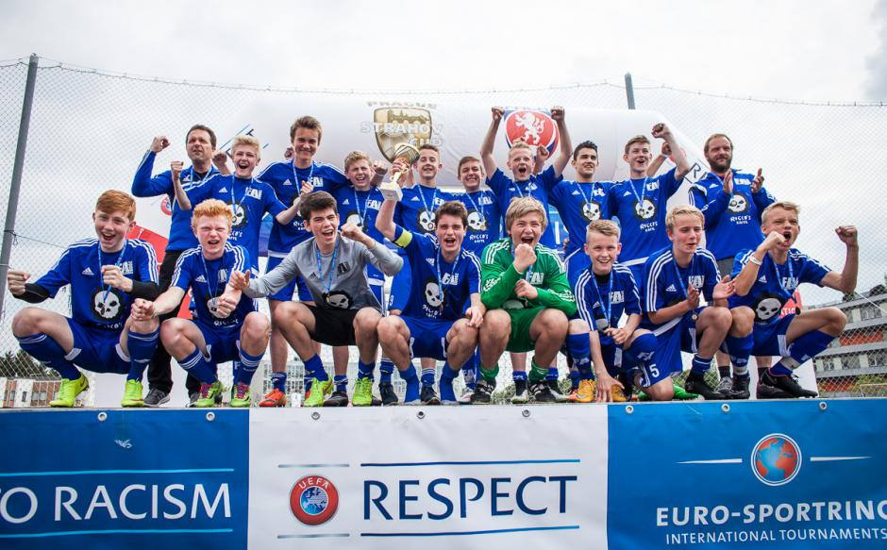
Poglavlje 5. Promicanje poštovanja kroz grupnu dinamiku
Primjer: The Respect Campaign (2008)
Sport je na svjetskog razini prepoznat kao alat za promicanje poštovanja.
Jedna od politika angažirana od strane UEFA-e 2008. godine je Respect campaign.
The European Commission support for the production of this publication does not constitute an endorsement of the contents which reflects the views only of the authors, and the Commission cannot be held responsi­ble for any use which may be made of the information contained therein.

Slide 77
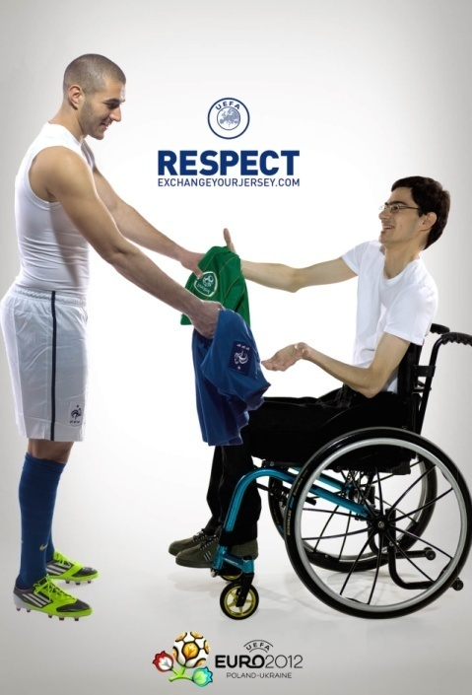
Poglavlje 5. Promicanje poštovanja kroz grupnu dinamiku
Primjer: The Respect Campaign (2008)
Cilj ove kampanje je promicanje poštovanja kroz javno angažiranje najpoznatijih nogometaša i pokazivanje logotipa kampanje na majicama i promicanje fair play-a na utakmicama.
The European Commission support for the production of this publication does not constitute an endorsement of the contents which reflects the views only of the authors, and the Commission cannot be held responsi­ble for any use which may be made of the information contained therein.

Slide 78
Poglavlje 5. Promicanje poštovanja kroz grupnu dinamiku
“Poštovanje” je opisano kao promicanje pozitivnih stavova prema:
Rasnim razlikama
Tjelesnim nesposobnostima
Spolnim razlikama
The European Commission support for the production of this publication does not constitute an endorsement of the contents which reflects the views only of the authors, and the Commission cannot be held responsi­ble for any use which may be made of the information contained therein.

Slide 79
Odjeljak znanja/ Zadaci za vježbu
Što je pristup Pozitivnog razvoja mladih?
Kako se može koristiti za promicanje poštovanja među djecom?
The European Commission support for the production of this publication does not constitute an endorsement of the contents which reflects the views only of the authors, and the Commission cannot be held responsi­ble for any use which may be made of the information contained therein.

Slide 80
Kraj 5. poglavlja
The European Commission support for the production of this publication does not constitute an endorsement of the contents which reflects the views only of the authors, and the Commission cannot be held responsi­ble for any use which may be made of the information contained therein.

Slide 81
Reference List
Adorno, T. W., Frenkel-Brunswik, E., Levinson, D. J., & Sanford, R. N. (1950). The authoritarian personality.
Allport, G. W., Clark, K., & Pettigrew, T. (1954). The nature of prejudice.
Crandall, C. S., & Eshleman, A. (2003). A justification-suppression model of the expression and experience of prejudice. Psychological bulletin, 129(3), 414.
Rokeach, M. (1960). The open and closed mind.
Tajfel, H., & Turner, J. (1986). JC (1986). The social identity theory of intergroup behavior. Psychology of intergroup relations, 7-24.
The European Commission support for the production of this publication does not constitute an endorsement of the contents which reflects the views only of the authors, and the Commission cannot be held responsi­ble for any use which may be made of the information contained therein.

Slide 82
Reference List
- Robbers Cave Experiment: https://www.youtube.com/watch?v=8PRuxMprSDQ
University of Oklahoma. Institute of Group Relations, & Sherif, M. (1961). Intergroup conflict and cooperation: The Robbers Cave experiment (Vol. 10, pp. 150-198). Norman, OK: University Book Exchange.
Bourgase B. Conflict within Teams. Coach Brock Bourgase.
-Dan. (2017). Playing Peacekeeper: Tips for Resolving Conflict Between Players. Steellocker Sports.
-Hedstrom R. Coaching Through Conflict: Effective Communication Strategies. Association for Applied Sport Psychology.
- Meredith J. (2016). Teach Your Young Athletes how to Fight. USA Football.
- Snider J. (2016). What to do when you don’t get along with a teammate. Future Stars Summer Camps.
The European Commission support for the production of this publication does not constitute an endorsement of the contents which reflects the views only of the authors, and the Commission cannot be held responsi­ble for any use which may be made of the information contained therein.

Slide 83
Reference List
Richter, L. M., Mathews, S., Kagura, J., & Nonterah, E. (2018). A longitudinal perspective on violence in the lives of South African children from the Birth to Twenty Plus cohort study in Johannesburg-Soweto. South African Medical Journal, 108(3), 181-186.
The European Commission support for the production of this publication does not constitute an endorsement of the contents which reflects the views only of the authors, and the Commission cannot be held responsi­ble for any use which may be made of the information contained therein.

Slide 84
Reference List
Lerner, R.M., & Lerner, J.V. (2006). Toward a new vision and vocabulary about adolescence: Theoretical, empirical, and applied bases of a “Positive Youth Development” perspective. In L. Balter & C.S. Tamis-LeMonda (Eds.), Child psychology: A handbook of contemporary issues (pp. 445–469). New York: Psychology Press
Weiss, M. R. (2011). Teach the children well: A holistic approach to developing psychosocial and behavioral competencies through physical education. Quest, 63(1), 55-65.
The European Commission support for the production of this publication does not constitute an endorsement of the contents which reflects the views only of the authors, and the Commission cannot be held responsi­ble for any use which may be made of the information contained therein.

Slide 85
Materijale su pripremili
Ambra Gentile, Antonino Bianco, Antonio Palma, Stefano Boca
UNIPA
The European Commission support for the production of this publication does not constitute an endorsement of the contents which reflects the views only of the authors, and the Commission cannot be held responsi­ble for any use which may be made of the information contained therein.

Slide 86
The European Commission support for the production of this publication does not constitute an endorsement of the contents which reflects the views only of the authors, and the Commission cannot be held responsi­ble for any use which may be made of the information contained therein.

